Slide 1
Testing
IN710 OOSD 2017
Session 5.1
Notes:
Testing is a very large topic, really a software development discipline of its own
Some of you may have taken the testing paper last semester, and for you, this will be a bit of a review.
However, it is so important that we all have to be on the same page with it.
We will concentrate today on the aspects of testing most important to developers.

Slide 2
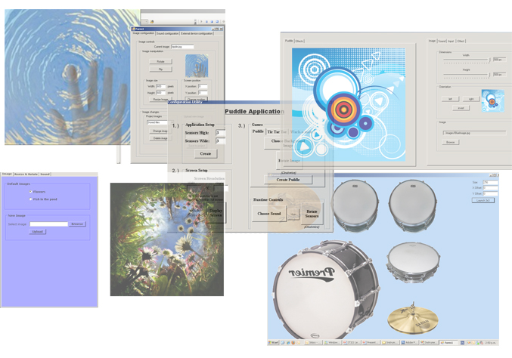
Our Code
Notes:
A few years ago in this paper, we built some control code for a foot-operated device.
There was a big pressure pad that sat on the floor and images were projected onto it from a projector on the ceiling.
When people walked on it, things happened. Some people used a graphics “ripple” module to make a water puddle effect; some people attached sounds clips so that users could play music with their feet.
And the code was beautiful and the interactivity was rich, so we set them up at expo.
And when we turned real users (end-users and admins) loose on them….

Slide 3
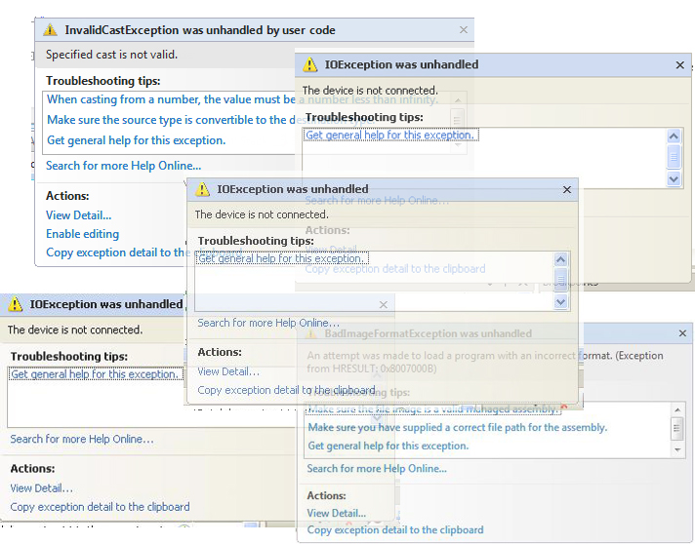
Our Code
Notes:
Oops.
So, what went wrong?
Mostly, inadequate testing.
Testing is not the same as debugging. Testing is exercising code that compiles and usually runs, and there’s a fair bit to it.
We tend to neglect it completely. If the code compiles and runs to the minimum spec, we turn it in and forget about it.
But of course that’s not how things work in the real world (including Project). Code lives and people use it.
So we need to consider a formal and rigorous approach to making sure it works.

Slide 4
Types of Testing
Unit Testing
Single logical unit (often a method)
Integration Testing
Behaviour that involves multiple units
Functional Testing
The entire application
Performance Testing
Is the application fast/powerful enough?
Acceptance Testing
Do the clients and/or users like the product.
Notes:
These are the general classes of testing.
The last two are really more of an issue in a commercial coding situation, but the first three are important for any piece of code that needs to work.
Lets look at how we test now

Slide 5
The Way We Test Now
Not at all
Try to test the whole application when we are finished implementing it.
With debugging statements that we delete.
With throwaway simulations (e.g. a button-click handler) that we delete
Notes:
None of these techniques is satisfactory
They sort of go from worst to least worst
Not testing at all, well obviously not good
Trying to test the whole app at the end is awkward because
If it breaks you won’t know where the bugs are
If you find the bugs, it will be a pain to fix them, as all the code will be tangled up together
Debugging statements are good as they mean you are “testing as you go”, but they’re a hassle to put in and take out.
Button-click testing tends to produce more accurate and complete simulations than debug statements, but it has the same shortcomings as debugging statements.
And both of those last two are no use at all for a living product, which will change. If you need to modify your code and you want to make sure you haven’t broken anything (e.g. if you change a class you need to be certain that all classes that use the changed one in composition or aggregation still work), you have to recreate all the debugging statements or button click handlers. Even if this just requires uncommenting a bunch of code, it’s tedious and potentially error prone.

Slide 6
Industrial Strength Testing
The testing modules are separate objects.
Their methods test our production code.
They cover all logic.
They are not thrown away.
They are easy to run.
The test suite can be run every time functionality is added/modified to make sure no existing code has been broken.
Notes:
Here’s what we want to achieve…
This approach can apply at all the five levels of testing, really, but it’s most often discussed in the context of the first – unit testing.
This is the testing for correctness of very small bits of code – the smallest logical unit.
This is testing done *by the developer* and done *during development*.

Slide 7
Unit Testing
So called because this testing targets the unit level.
A unit of code is any element that contains logic (a conditional, loop or computation).
Different from debugging, in that you are testing code that compiles and runs.
Different from integration testing which targets logic involving multiple units.

Slide 8
A Unit Test
A permanent piece of code that exercises some aspect of our production code.
Notes:
So we write a little method that does something.
Like the button-click handlers we tend to use now.
But instead of throwing it away by deleting the button before deployment, we keep it around and use it over and over throughout the lifetime of the product.
As we will see, there are development tools that help you with this process. Some of you will have seen JUnit in Programming 3.
There is a similar tool called NUint for use with Visual Studio if you must have it.
However, we will focus on the in-built testing support in VS2010, which is known as MSTest.
It is completely integrated into VS, powerful and easy to use.

Slide 9
When to Write a Unit Test
"Whenever you are tempted to type something into a print statement or a debugger expression, write it as a test instead.“
Fowler
Notes:
Fowler (Martin) is a smart guy. Read what he writes.
The logic is that if you need to test it at all, you write a test for it.
No test code should ever be disposable.
The question of “how many tests” and “what tests” you need to write to thoroughly test a product is a very complicated one.
This is part of what makes testing difficult and makes people reluctant to do it correctly.
We will discuss some formal approaches for being sure you are at least writing the bulk of the tests you need.

Slide 10
Simplest Case
class utilities
{
public bool isNegative(int n)
{
if (n < 0)
return true;
else
return false;
}
…..
Notes:
Imagine that you want to know if this piece of code is logically correct
Ignore the fact that you could verify it by inspection for now, ok? We just want a simple example for the purposes of illustration
How might we test this?
We could drop a button on the form and make a utilities object and call it with a number and write the result out to the form or a MessageBox even
We would then delete the button.
We would assume that this method would be forever correct. Again because this is such a simple example, that is probably safe.
But what if we were looking at a method that relied on some other object. If we changed that object’s behaviour, we could break this method.
So we would like to write a test that we wouldn’t throw away.
We’d like it to be part of a test suite that we could run over the whole program to make sure everything was working
So we make a class to hold all the little test routines.
We give that class a method that simply tests whether this function returns the correct answer when given a negative number

Slide 11
Simplest Unit Test
public bool isNegativeTestOnNegativeValue()
{
utilities target = new utilities();
int n = -15;
bool result = target.isNegative(n);
if (result == true) //the correct result
return true;
else
return false;
}
Notes:
This is what the typical unit test would look like
You set up a case for which you know the correct answer, then make sure that it works
This structure is called “Arrange, Act, Assert”
Set up (arrange), exercise the method of interest (Act), check that the result is what you expected (Assert)
The test method returns true (succeeds) if the method works as expected and false (fails) if the method doesn’t work as expected.
You could write another version to test a positive value and another to test 0
(Note the goofy name; unit testing protocols produce the most ridiculous method names ever, but they serve to let you know exactly what bit of logic each is testing.)
You could make a sort of testing engine method that ran them all and made sure they all returned true
At any given moment you could run the whole engine and make sure all your logic was behaving as it should
This probably all seems quite labour intensive and, if you did it all by hand, it would be
That is why we have testing frameworks..
These testing frameworks supply test skeletons, provide special logical comparators, organise all the tests, check the outputs, etc.
We will look at Visual Studio’s framework in a minute.

Slide 12
Example 2
public double computeArea(double width, double height)
{
double a = width * height;
return a;
}
Notes:
Let’s think about this method.
It is intended to compute the area of a rectangle.
Look at the code there….
Is it right?...Maybe…
Let’s think of a good test to write for this code.
The obvious one is to see what happens with a particular height and width…

Slide 13
Test for Example 2
public bool computeAreaTest()
{
utilities target = new utilities();
double width = 5;
double height = 10;
double result = target.computeArea(width,
height);
if (result == 50)
return true;
else
return false;
}
Notes:
Here’s a test you might write for the computeArea method
Arrange, Act, Assert
This test will pass (i.e. return true). Can you now be confident that the computeArea method is logically correct and any code that uses it will be correct?
No.
If you call computeArea with a negative number as an argument, it will return a negative area, which is obviously wrong
You need to write a test for this and make sure that your production code copes correctly
This example highlights the fact that the simple act of writing some unit tests does not insure code correctness. The tests have to be right as well as the production code.
However, the general position is that any tests are better than no tests at all.

Slide 14
The Good Unit Test
Good unit tests have the following properties:
Automatic
Thorough
Independent
Professional
Hunt & Thomas, Pragmatic Unit Testing
Notes:
Before we start working through an example, let’s just identify the important properties of a good unit test.
BTW, these are based on a book called “Pragmatic Unit Testing” by Hunt & Thomas, which is a good book on Unit Testing.
Some books out there (especially the TDD ones) can be more than a little over the top, but Hunt & Thomas is quite sensible.
Automatic - they should run without human intervention, e.g. entering data into a text box
Thorough - they should test every aspect of the system
Repeatable - they should lead to the same results no matter how often you run them
Independent - they should be independent from the environment and each other. They should test only one thing at a time.
Professional - they should be written and maintained to the same professional standards as your production code

Slide 15
Testing Dependent Code
How do you independently test a method that:
Uses an instance of another class
Uses a method of another class
Uses an external entity (e.g. file system, printer, database)
Notes:
The previous examples were the simplest possible situations, because they were logically straightforward and, more importantly, they were not dependent on any other objects.
We just said that we should test only one thing at a time.
This is a good idea. If you write a test that exercises two classes and the test fails, where is the error? Class 1? Class 2? Or both?
So how do we test a method that uses another class instance or another class’s methods?
We stub it.
The stubbing approach is easy to use and involves no extra dependencies for the unit test. The basic technique is to implement the collaborators as concrete classes which only exhibit the small part of the overall behaviour of the collaborator which is needed by the class under test.

Slide 16
Testing Dependent Code
Stubs
Notes:
To achieve this, we write stubs.
Stubs are little methods that simulate the real method upon which we are dependent
Anytime you replace reading from a text box with a constant in the code you were effectively writing a stub
But the situation can get a little more complex….

Slide 17
Stubs
Example (following Osherove):
public class Admin
{
public bool isLogInLegal(String userName, String password)
{
// query the database for a record holding these values
// return true if such a record is found
}
…..
}
Notes:
As an example, think about code you might write to check that a user’s provided username and password are legal
The problem is that you can’t test the checking logic without having access to the database

Slide 18
Stubs
isLoginLegal
Database
Notes:
Your method is directly dependent on something that you can’t really control directly
So what you need to do is replace the dependancy with something you can control….

Slide 19
Stubs
isLoginLegal
DataBaseManager
Database
Notes:
Like this
This is called “adding a layer of indirection”
You will write a dataBasemanager class who talks to the database
The isLoginLegal method can call a method exposed by the databasemanager
In the production code there will be a real databasemanager class
But in your testing, you can write a fake one….

Slide 20
Stubs
isLoginLegal
IDataBaseManager
StubDataBaseManager
DataBaseManager
Database
Notes:
Note IDatabaseManager. What do you think that is? => An interface.

Slide 21
Stubs
public interface IDataBaseManager
{
bool QueryForRecord(String userName, String password);
}
Notes:
The interface might look like this

Slide 22
Stubs
Class Admin now needs an IDataBaseManager object
public class Admin
{
IDataBaseManager dbManager;
public Admin(IDataBaseManager dbManager)
{
this.dbManager = dbManager;
}
}
Notes:
This can be done at construction time, or via a set/get

Slide 23
Stubs
isLoginLegal now calls the appropriate method from IDataBaseManager
public bool isLogInLegal(String userName, String password)
{
ResultType = dbManager.QueryForRecord(userName,
password);
if (ResultType indicates success)
return true;
else
return false;
}

Slide 24
Stubs
For testing, you write a stub
public class StubDataBaseManager : IDataBaseManager
{
public bool QueryForRecord(String userName, String password)
{
return true;
}
}
Notes:
This is the stub for exercising the admin method when the database returns true
You would also write one for when the database returns false

Slide 25
Stubs
The test then uses the stub in exercising the admin class
public bool testIsLoginLegalOnTrue()
{
StubDataBaseManager stubDbManager = new StubDataBaseManager();
admin adminForTesting = new Admin(stubDbManager);
bool expected = true;
bool actual = adminForTesting.isLogInLegal("legal", "legal");
if (expected == actual) // test passes
return true;
else
return false;
}
Notes:
In the test you create a new stubDBManager and a new admin class object that takes it
Then you run it and check your results.
Note that the values you pass in aren’t relevant except to get compilation

Slide 26
Stubs
Note that in this example, you have designed your architecture specifically to facilitate unit testing
Notes:
The whole process of adding the interface to the database was something you did so that you could write a test.
Think about this as we continue….
We will discuss later.

Slide 27
Automated Testing Frameworks
Examples
jUnit
nUnit
MSTest: Built-in VS 2015
Advantages
Automatic test skeleton construction
Built-in assert operators for validation
Automatic running and checking
Notes:
The creation of all the tests and running of all the tests and looking for any false results can get tiresome
Therefore, people have developed automatic testing frameworks
These are the main ones
They all work basically the same

Slide 28
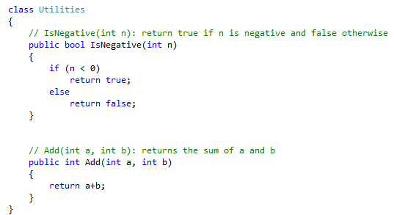
MSTest
Notes:
Let’s assume we have this little class with these little methods and we want to test them
These methods are so simple that we could probably test them thoroughly just by inspection, but they will serve as examples for how to work with MSTest.
Also, there are some testing purists that say that no method is so simple that it doesn’t need testing.
We will discuss testing philosophies more in a few minutes.

Slide 29
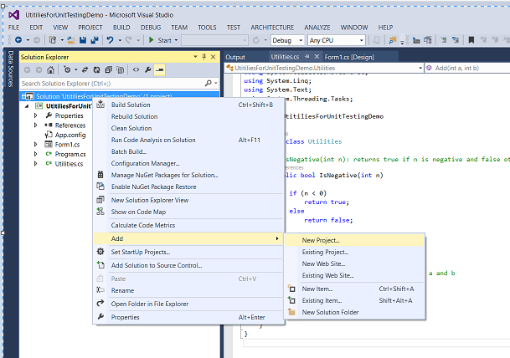
MSTest
Notes:
We start by adding a new project to our current solution
Right click on the solution (not on the Project) in the Solution Explorer, select Add->New Project
This will be the project that holds all the tests

Slide 30
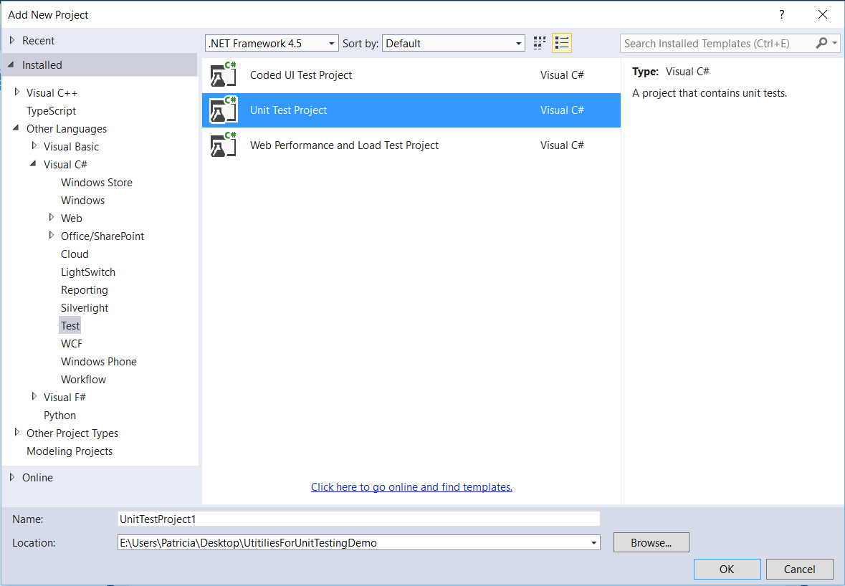
MSTest
Notes:
Select Test and Unit Test Project
This part is very important. If you don’t select these, you will just have to start over.

Slide 31
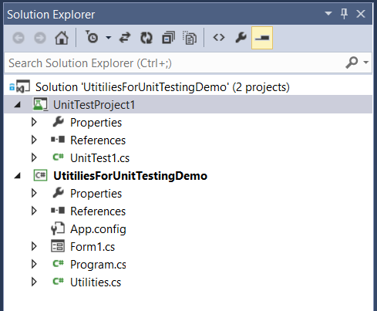
MSTest
Notes:
In the Solution Explorer, it looks like this.
(Projects will appear in alphabetical order, so your test project can also come second...)
You can still see Utilities.cs in your original Project
You now also have a second project that contains a file UnitTest1.cs (or whatever you named it).
Let’s look at that file...

Slide 32
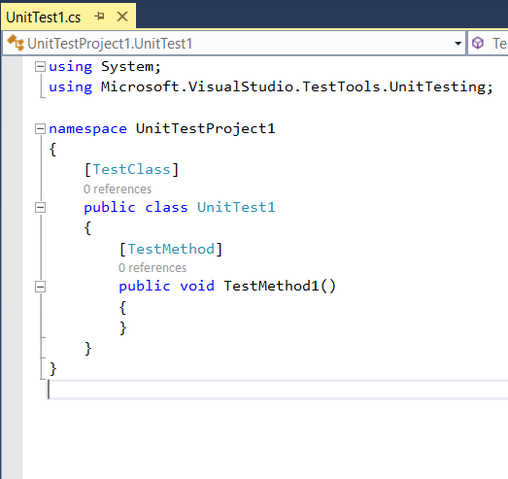
MSTest
Notes:
The system has created a class and put into it one empty method.
This is a template for how you construct your test classes and their methods.
What you want to note about these are the annotations (the words TestClass and TestMethod in square brackets).
These are essential. It is with these annotations that VS is able to distinguish between your actual code and your tests.
You can create a Unit Test for a method either by hand or using the Wizard in VS 2015. Do get the Wizard, right click on the method (in its class code) and select Create Unit Tests. My feeling is that the Wizard is more work than it’s worth, but you should try it; you might prefer it.
You can now augment this class by adding as many unit tests as you need.
(To calibrate, in practical today you will build a single class and test it. My solution has 27 tests.)

Slide 33
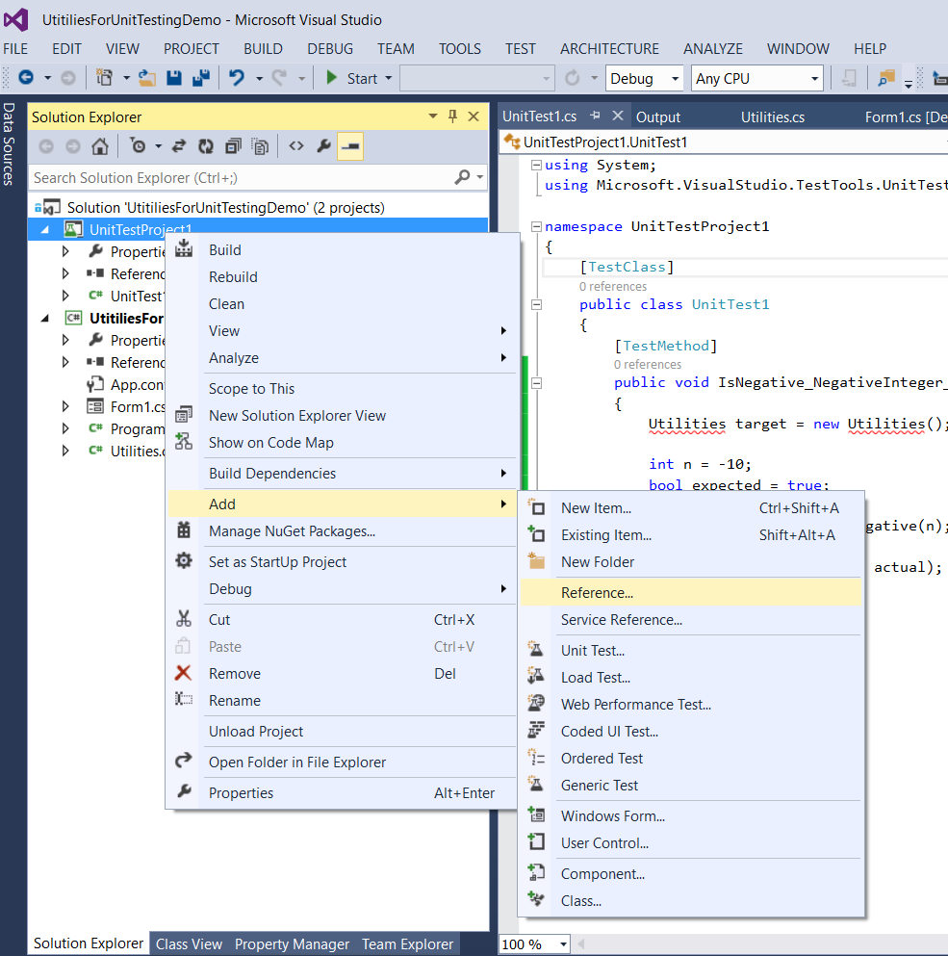
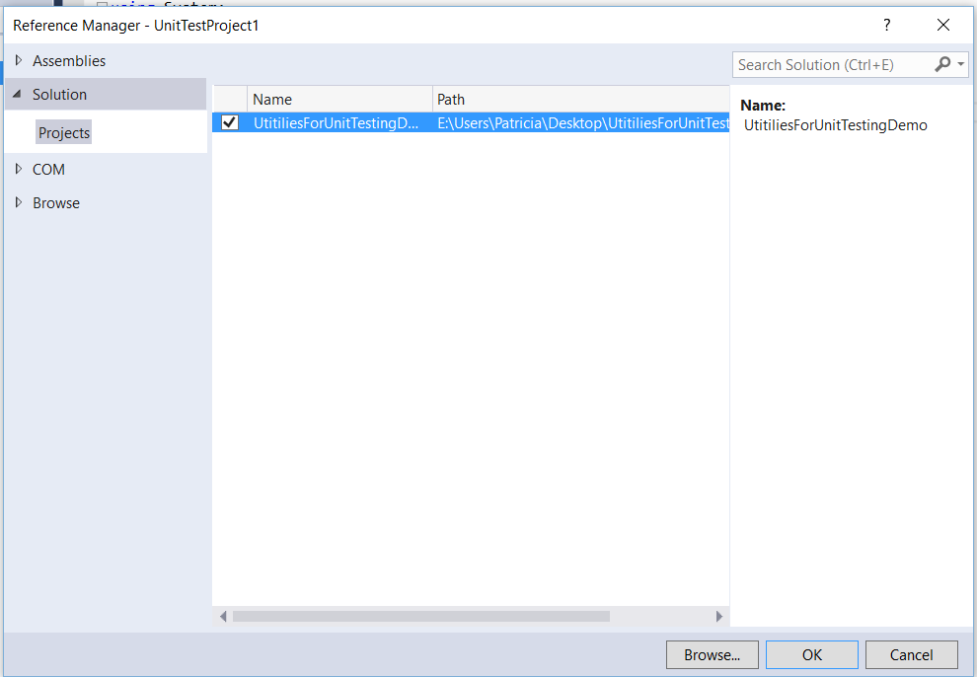
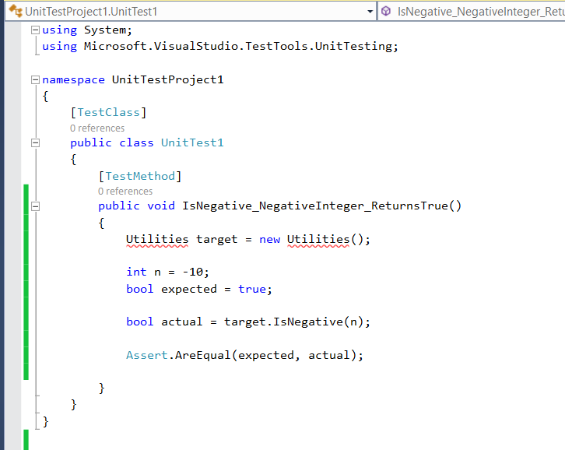
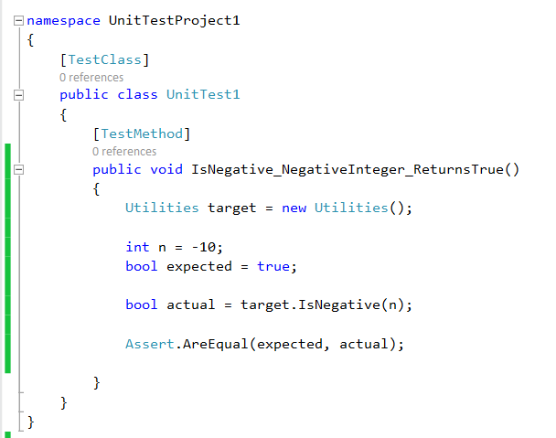
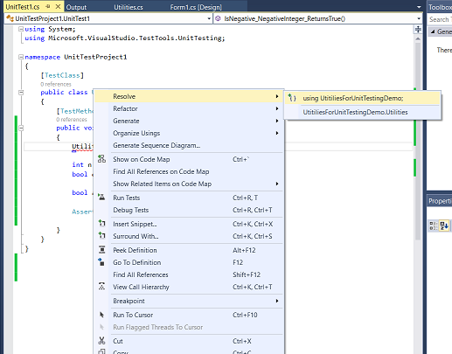
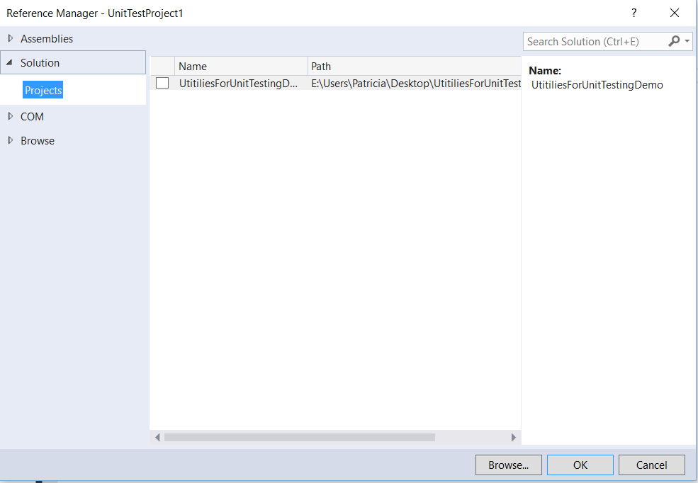
MSTest
Notes:
Here is what a typical test for IsNegative
Three normal things to note:
The Arrange, Act, Assert structure
The weird method name. This is conventional in Unit testing. The protocol is MethodName_Scenario_ExpectedBehaviour
The test method returns void and takes no input arguments. This is a requirement for all test methods (small extension to be discussed later).
NB: You will have to add a using statement for your main project. Although the two projects are in the same Solution they can’t see each other.
It is best to do this via the “quick solutions” context menu in the Test project, rather than doing it by hand.
If you let VS do this for you, it will add a reference (some necessary metadata). If you do it by hand, you have to add the reference yourself.
It is worth learning how to do this (it’s a bit fussy) but we’re concentrating today on the unit testing, so just let the system help you out.
We can add as many methods to our test class as we wish. We simply annotate each with [TestMethod]. What other tests might you write for IsNegative?
A positive number
Important => 0
Do you need to test it with a decimal? => No. That will not compile. You don’t need to test for compilation errors.
Do you need to test it with a char? => Yes. Underneath, the system believes char are int, so a user can call IsNegative passing in ‘b’, and it runs just fine.
Why would a user ever do this? A typo. Probably not on purpose, but there’s no point only testing that your code works when things go perfectly.
What is the expected behaviour in this case (if the input is ‘b’)? The method actually returns false. But is this correct? There is no way definitionally to establish this. It is a decision you have to make.
Assume you have written all the tests you want for IsNegative. We then write tests for our other method, Add(int a, int b)…

Slide 34
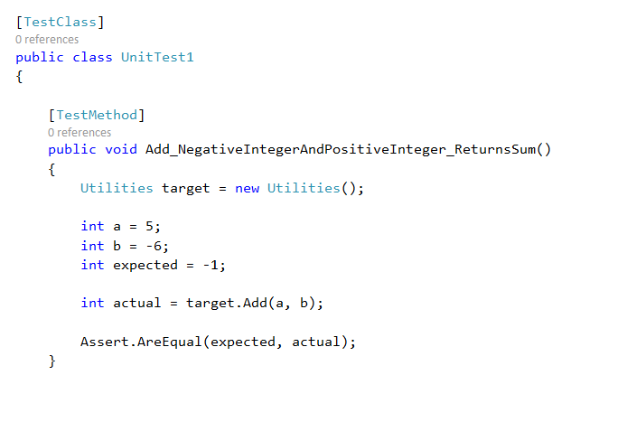
MSTest
Notes:
Here is one possibility…
Note that the method is inside the UnitTest1 class, and correctly annotated.
The structure is identical to the previous test.
Note that you are working out the correct result here with 5 + -6 = -1
What if you got that wrong? What if there is a bug in your test?
Well, then your tests aren’t logically sound and this can certainly lead to all kinds of trouble.
Be careful with your tests.
Fortunately, since a good test is highly focused and tests only one thing, they are less likely to be buggy than your complex production code.
In mission critical situations, can you formally test your tests? Yes, but this is out of scope for us.
Assume now that you have written all the tests you need at a given moment.
We now want to run them all at once and automatically...

Slide 35
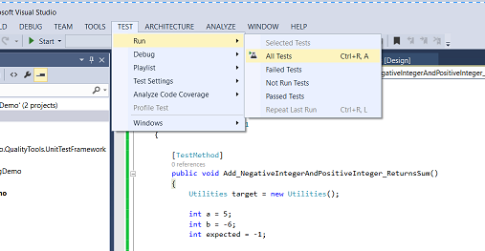
MSTest
Notes:
It’s easy to run the tests…
If your solution contains a test project, you will have the Test menu

Slide 36
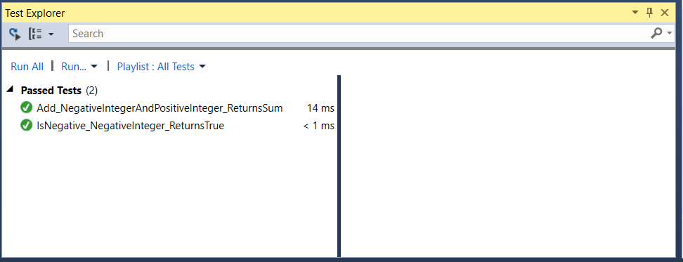
MSTest
Notes:
And your output is automatically generated, with each test marked as passed (green check mark) or failed (red x; we’ll look at an example in a minute).
You can imagine how useful this is when you have hundreds or thousands of tests

Slide 37
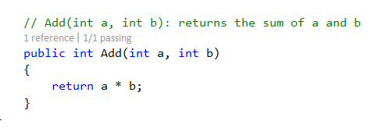
MSTest
Notes:
Imagine that we had written our Add method like this. These things can happen.
What’s our test output?

Slide 38
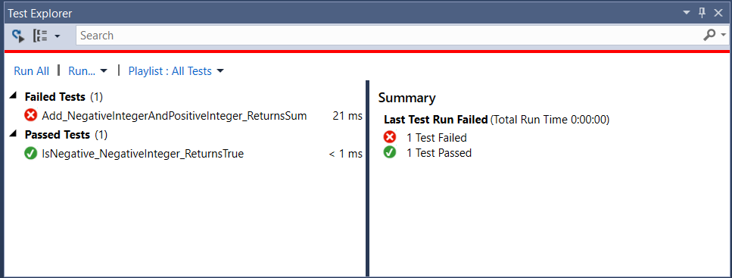
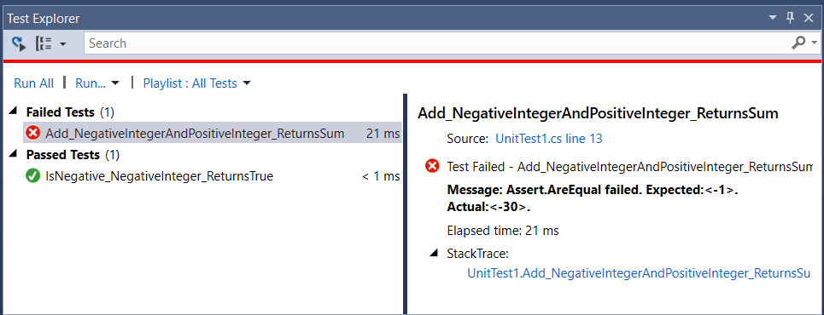
MSTest
Notes:
The red x says it failed
Double click on it and you’ll get more details...
You can see that Expected was -1 and Actual was -30.
Oops.
You now go back and look at your code and figure out what went wrong.
That’s the basics of MSTest, and we will have a play in practical.
Now for that small technical matter....(then a little discussion of attitudes toward unit testing, then some practice).

Slide 39
Philosophies of Unit Testing
Notes:
But first, let’s think a little more closely about the philosophy of unit testing.
A simplistic view is that UT is a magic bullet and anyone who doesn’t UT is an idiot, and so forth. This is what you will read on StackOverflow.
But it’s more complicated than that...

Slide 40
Advantages of Unit Testing
Produces robust code, especially in the boundary areas
Improves the design
Increase confidence in code stability
Encourages collective ownership of the code
Enables refactoring without fear
Notes:
Everyone agrees that you should do it,
Improves the design: Remember when we had to refactor in order to test? It is maintained that this type of refactoring – to produce testable code – automatically produces better code (cohesive and uncoupled)
Collective ownership: With the test suite supporting you, anyone can safely touch any part of the code. As long as the test suites passes, no harm has been done. This prevents the “code possessiveness” problem that often occurs in large development projects where person A doesn’t understand person B’s code.
but there is a lot of variation on “when” and “how much”.
At the most extreme end, you get an approach that makes the tests and the test suite just as important as the production code (or maybe more…).
This is TDD.

Slide 41
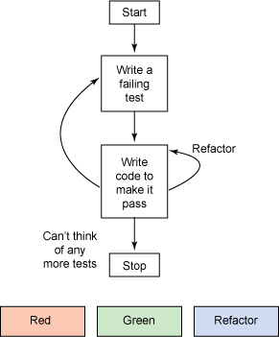
Test Driven Design
Write the tests first, then the code to pass them
Notes:
Unit testing is so popular in some circles that it has created an entire software engineering theory called test-driven design
Part of the Agile/Extreme family
In its purest version TDD dictates a specific and very quick code cycle
Write a test that fails because the functionality isn’t implemented yet
Write the minimum amount of code to make it pass, even if the code is crappy
Refactor the code until it is good
Proponents maintain that you get clean, tight code this way.
Thoughts?
Write the tests first is smart, because it forces you to exactly specify the behaviour of your method.
Iterative testing is smart because when you make changes you should test again.
Minimum code and refactor is (IMO) just dumb. Writing good code the first time can never be a worse idea than writing bad code the first time.
As always, approach the zealots with a scepticism, but don’t throw out the baby with the bath water.

Slide 42
Write the Test First
Write the test before the code.
Run the test, confirm that it fails.
Write the code.
Run the test again, confirm that it passes.
Notes:
Here is one aspect of TDD that you should consider.
Why would you do this?
Remember that we said it was important that your tests not be buggy?
This is one way to avoid some very nasty test bugs.
An example…

Slide 43
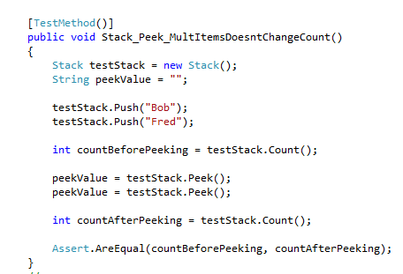
Write the Test First
Notes:
Imagine we have built a stack class (LIFO collection with push, pop, peek and count) and we want to test it
One of the things we want to test is that when we call peek, the count doesn’t change (which it shouldn’t because peek doesn’t remove any items from the stack.)
Assume that we have already thoroughly tested push and peek so we know they work correctly, here we are only interested in count.
So we might write this test…
We make a new stack, push two items and call count.
Then we peek twice and call count again.
Both calls to count should return 2 so we check that before and after are equal.
Assume this test passes. Can we be confident count works?
No. This test will actually pass if count just returns -1 every time (i.e. you forgot to write the actual code for it).
The problem is that your logic is wrong here. You can’t test count against itself. Must test it against the known correct result.
So, that assert should simply compare countAfter to 2.
Note how “write tests first” would have helped you to see this problem. This test would pass before you have actually even written the count method, and that would have been a clear signal to you that the logic of the test was wrong.
So one of the recommendations of TDD is:
write empty method handlers (just return some impossible value to get functions to compile).
Write all the tests you want to have your code pass.
Run them and verify that they all fail. This means they are actually testing sensitively for the errors they are supposed to test for.
Now write your methods, and work on the code until all tests pass.

Slide 44
Differing Views on Unit Testing
Rabidly Opposed
Rabidly In Favour
Notes:
Your real TDD purists will say that the tests are more important than the code itself
They will say that 100% coverage is essential
They will say that 40-50% of development time should be being spent on writing tests
Like all IT things about which people go slightly insane, these people are wrong.
And, in fact, the unit testing frenzy is starting to pass. Although it’s a very new idea, already it is starting to lose favour within the coding community, at least in its extreme forms
Experience has not demonstrated sufficient returns on time invested at the mad extreme end.
This does not mean that the unit testing approach is bad. It’s not. The idea of a permanent, automated set of tests to run on your code is a sound one, especially if you want to be able to add functionality over time without having to worry about having broken things that were working before (regression).
But once again, it turns out the judgement is called for in the application – moderation in all things, including unit testing.

Slide 45
Differing Views on Unit Testing
Will Shipley
“You should test. Test and test and test. But I've NEVER, EVER seen a structured test program that (a) didn't take like 100 man-hours of setup time, (b) didn't suck down a ton of engineering resources, and (c) actually found any particularly relevant bugs. Unit testing is a great way to pay a bunch of engineers to be bored out of their minds and find not much of anything.”
Notes:
Famous coder

Slide 46
Differing Views on Unit Testing
‘Let me be blunt: YOU NEED TO TEST YOUR DAMN PROGRAM. Run it. Use it. Try odd things. Whack keys. Add too many items. Paste in a 2MB text file. FIND OUT HOW IT FAILS. I'M YELLING BECAUSE THIS S*** IS IMPORTANT.”

Slide 47
Differing Views on Unit Testing
‘When you modify your program, test it yourself. Your goal should be to break it, NOT to verify your code. That is, you should turn your huge intellect to "if I hated this code, how could I break it…You KNOW that if you hated someone and it was your job to break their program, you could find some way to do it. Do it to every change you make.”
Notes:
In between robo-testing and bohemian bacchanalia testing is the correct method.
But this suggestion will always be good…

Slide 48
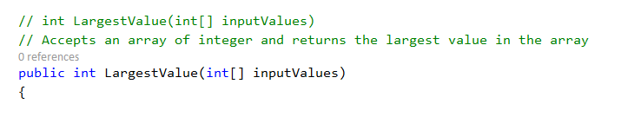
Practice
Notes:
We’re going to work through a testing scenario now, and we’ll do it as a group with some discussion, but you’ll be writing some code as we go.
Here is the method we are going to test.
NB: We are going to start with a version of this method WHICH HAS BUGS. I KNOW IT HAS BUGS. IT IS SUPPOSED TO HAVE BUGS (so we can practice finding them). PLEASE DO NOT REMOVE THE BUGS. PLEASE DO NOT POINT OUT THE BUGS. Just go with me on this one.
This exercise is based on one from Hunt & Thomas. Again, if you’re looking for a sensible book, I recommend this one.
Here is the method we are going to test
There is a well-known algorithm for finding the maximum: Loop through the collection. For each element, if it is greater than the current maximum, it becomes the new maximum. At the end return the current maximum.
That’s the algorithm we are going to use.
Before we look at any code, let’s decide what tests we need to write…

Slide 49
Practice
What tests do we need to write?
public void LargestValue_MaxValueLast()
public void LargestValue_MaxValueFirst()
public void LargestValue_MaxValueMiddle()
public void LargestValue_OnlyOneValue()
public void LargestValue_Duplicates()
public void LargestValue_AllNegatives()
public void LargestValue_MixedPositiveAndNegative()
Notes:
The general pattern is to map input to output. That is, for a specific input, what should the method return?
We try to come up with input examples that cover all the important situations, and verify that each works correctly.
Obviously, we put in some numbers and get out the largest. Should check at least 3 (allowing first, last, middle) So [7,8,9] -> 9
Order shouldn’t matter, so let’s also test [9,7,8]->9 and [8,9,7]->9.
What if there are ties? Let’s test [7,9,8,9,6] -> 9
What if there’s only a single element? [7]->7
What if there are negative numbers? [-7, -8, -9] -> -7
That looks like a good start.
(Defer “empty array” for a minute…)
The advantage of this is that it requires us to think about the possible input space and how the method should work across that space.
If we can get our method to get all these right, we can be much more confident that it is right than if we just write it and go.
So we are going to be writing a lot of tests for this one method and they all need different names.
Unit testing naming conventions follow a ClassName_MethodName_LogicalDescriptor sort of format.
We only have one class so we’ll skip that, so out test methods would be named something sort of like this…
Download the setup project from the I drive now….

Slide 50
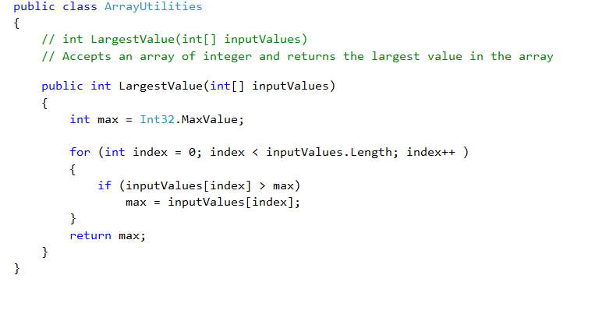
Practice
Notes:
Here’s the code we are going to start with…
YES, I KNOW IT HAS BUGS. SEE PREVIOUS SLIDE.
We aren’t going to modify the code just yet EVEN IF WE SEE BUGS. We are going to write some tests first and see how that helps us to find bugs.
Keep in mind that even if you can see the bugs in this simple example by inspection, you will not always do so. If you don’t believe me, think: have you ever had a bug in your code? Well, ok then.

Slide 51
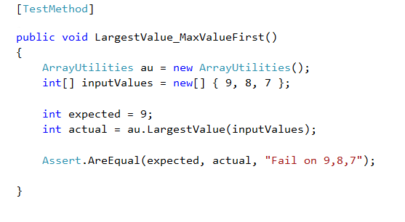
Practice
Open the setup project
Add a unit test project to the solution
Write a test method for LargestValue to test the case where the largest number in the array is in the first position.
Notes:
Working in pairs is good now…
So we want to test [9,8,7] and see if it returns 9
Just write the method, don’t run it yet.
Here’s mine.
Some things to note:
Get the name right. Here we’ve given up on describing the expected behaviour. This is ok.
Always create a class instance to exercise
Set up for the test (arrange)
Exercise the method.
The Assert.AreEqual has a third parameter which is the error message you want to see if your test fails.
You should find some C# documentation and read about the Assert class, it is fancy.
When everybody has something approximately equivalent to this, run the test (Test->Run->All)

Slide 52
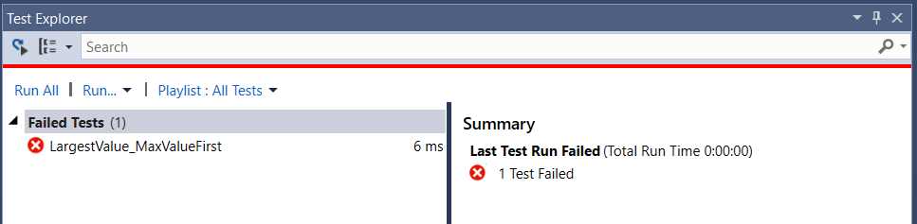
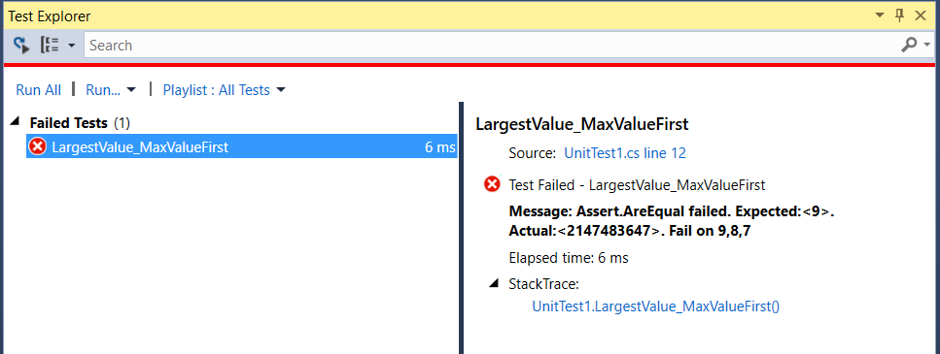
Practice
Notes:
Rats.
It failed.
Look at the output.
What is the problem?
Return 2**32 instead of 9
Look at the production method. Note that it is marked as having failed a test.
Where is the bug?
Should be Int32.MinValue, not Max.
Change and rerun => Passes. Yay!

Slide 53
Practice
What about an empty array?
Notes:
You have to consider all the things a user might do with your method.
One of the things they might do is call it with no input (i.e. an empty array)
This can happen. Maybe there is a bug in the code they wrote to fill the array. Or maybe the code they wrote sometimes returns an empty array correctly (e.g. a database fetch with no matching records).
What will your method do (after all the preceding tests pass?) => return -2**32
Is this right?
What do you want to have happen? Logically, what is the correct answer to “largest element of an empty array”?
=> Probably you should throw an exception (specifically, an ArgumentException). When there is no correct answer, that’s what code does.
Again see how test-first has forced you to think about how your code should work. This is a good thing.
MSTest has a facility for testing the outcome “This exception is thrown”.
Figure out how to test for that.
Write the test.
The test should fail.
Fix your LargestValue method so that the test passes.

Slide 54
Unit Testing Practical
Implement a Stack class. (See handout for details.)
Bring running version to class on Thursday
We will run your class against my test harness.
Notes:
I will be in my office from 8-10 on Friday if anyone needs any help, but no formal class.

